Slide 1

ONLINE PAYMENT FRAUD DETECTION
Using Machine Learning

Slide 2
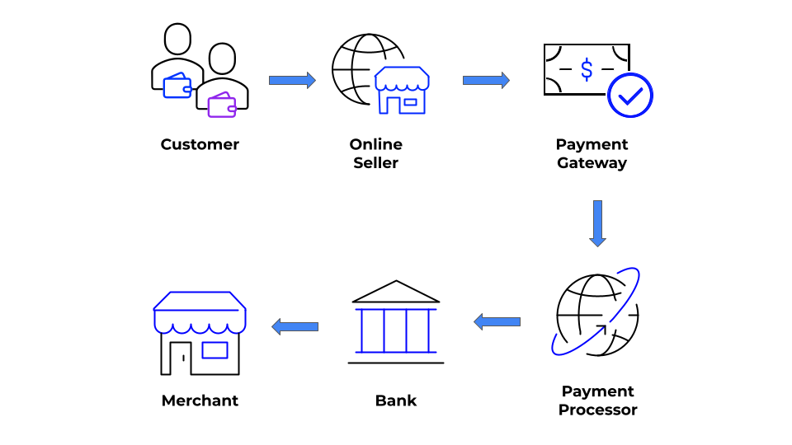
The Rise of Online Payment Industry
Online payment process refers to the electronic transfer of funds between buyers and sellers conducted over the internet. It involves the use of various payment methods such as credit cards, debit cards, e-wallets, and online banking to facilitate transactions.
The online payment industry is a part of the e-commerce industry and has rapidly grown in recent years due to the increasing adoption of digital transactions. It encompasses a range of businesses including payment gateways, payment processors, and digital wallets, among others. The industry is driven by the need for faster, safer, and more convenient payment options for consumers and businesses alike.

Slide 3

Online Payment Fraud
The fraudulent transactions can include activities such as phishing scams, account takeover, and money laundering, among others
To predict online payment fraud, we can use machine learning models that are trained on historical data of fraudulent and non-fraudulent transactions. By analyzing various features such as the transaction amount, type of transaction, and the behavior of the user, we can identify patterns and anomalies that are indicative of fraudulent activity.

Slide 4
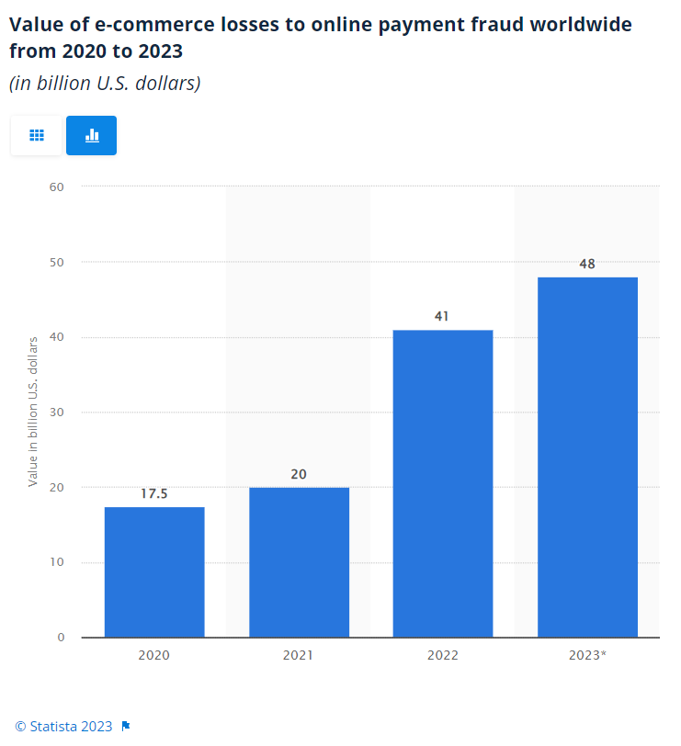

Slide 5


Slide 6
Is it necessary to predict online transaction fraud?
It is essential to predict online transaction fraud to safeguard both individuals and businesses from financial losses. With the increasing use of digital payments, fraudulent activities have also increased, which can have a significant impact on both personal finances and business operations.
For individuals, falling victim to online payment fraud can result in unauthorized charges, loss of funds, and identity theft. It can also lead to a damaged credit score, making it difficult to obtain credit in the future.
For businesses, online payment fraud can result in significant financial losses, damage to reputation, and legal consequences. It can also lead to a loss of customer trust, which can be challenging to regain.
Therefore, predicting and preventing online transaction fraud is crucial for maintaining the financial security of individuals and the success of businesses.

Slide 7

Online Payment Fraud: Impact on Businesses and Individuals
Effects on a Business:
Financial losses due to fraudulent transactions.
Reputational damage and loss of customer trust.
Increased costs associated with implementing fraud prevention measures.
Legal and regulatory penalties.
Effects on an Individual:
Financial losses due to unauthorized transactions.
Damage to credit score.
Increased risk of identity theft.
Emotional distress and frustration.

Slide 8

Advantages of Online Payment Transaction Fraud Detection
Early detection and prevention of fraudulent activities
Protection of businesses and customers from financial losses
Increased customer trust and confidence in online payment systems
Compliance with legal and regulatory requirements
Reduction in chargeback fees and other associated costs
Identification of potential weaknesses and vulnerabilities in the payment system
Improved operational efficiency and reduced manual intervention in fraud detection and prevention

Slide 9
Approach to the solution
I am using a dataset based on an Online Payments Fraud Detection Dataset with featureconsists of various features such as step, type, amount, nameOrig, oldbalanceOrg, newbalanceOrig, nameDest, oldbalanceDest, newbalanceDest, and isFraud, which provide information about online transactions and whether they are fraudulent or not.
Steps:
Data preprocessing.
Data visualization.
Model fitting.
Predictions.
Hyper parameter tuning
We will see everything in detail once we switch to code file.

Slide 10
Outcome
Online payment fraud is a major concern in the digital world. Fraudulent orders and payments can cause significant losses to businesses and individuals.
Detection of fraud manually is a daunting task due to the large volume of transactions.Machine learning models can be trained to detect patterns that may lead to fraudulent orders.
Effective fraud detection can help reduce financial losses and maintain customer trust. Using machine learning models can increase the accuracy and efficiency of fraud detection

Slide 11
Future Improvements
Feature engineering: Investigating and extracting additional relevant features can improve model accuracy.
More data: Adding more data to the training set can increase the model's accuracy and generalization.
Ensembling: Combining the predictions of multiple models can improve the overall performance.
Use deep learning models: Deep learning models such as neural networks have been shown to perform well on imbalanced datasets, and can be used to improve classification performance.

